Slide 1
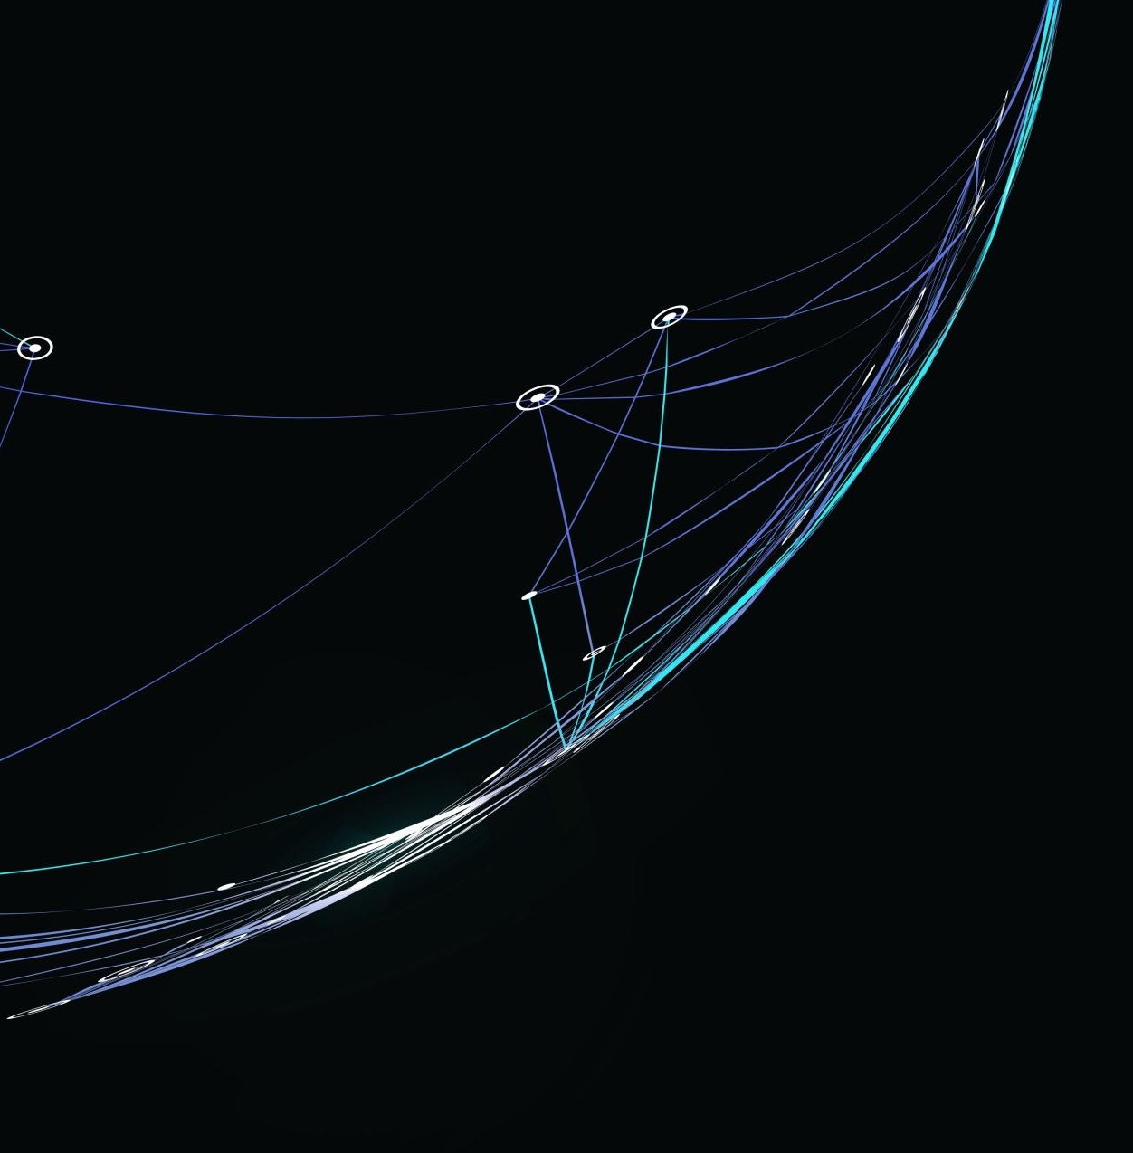
Networking
Internet of Things (IoT)
Arman Pabla
December 17, 2022

Slide 2
Introduction
“ The fundamentals of networking play a vital role in the world of IoT. The design and development process of building a network includes SOHO router configurations, subnetting, connectivity testing, network documentation, and SOHO wireless network security. This foundation enables the learning of emerging technologies, including IoT, and prepares for the future of the Information in Technology.” – DeVry University
This course covers the essentials of knowing the Network

Slide 3
Addressing On Networks
Objective:
Implement an IPv4 addressing scheme to support a network. We will assign an IPv4 address to the SOHO Router virtual machine.

Slide 4
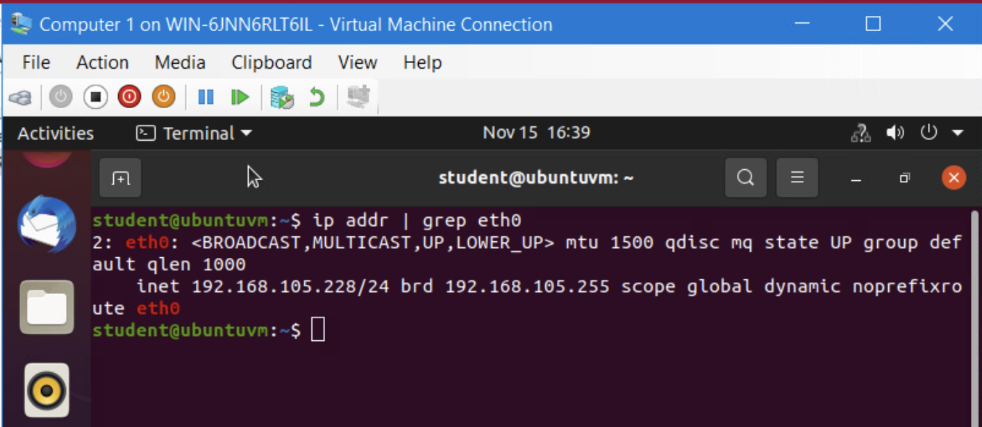
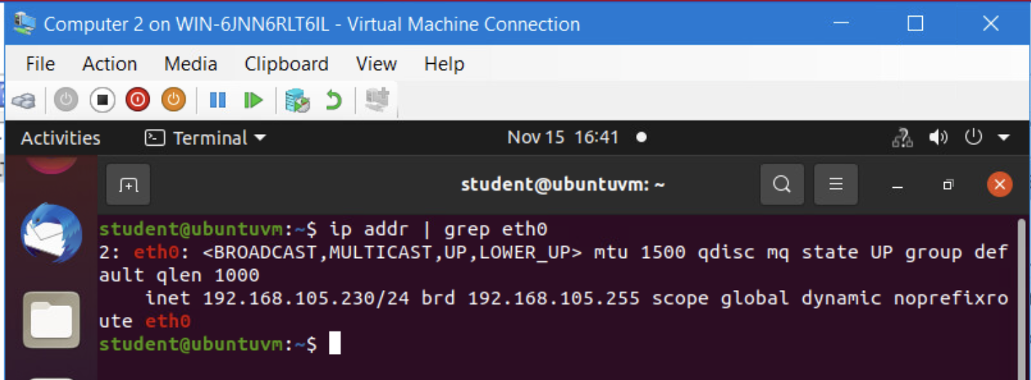
Protocols and Routing
Objective:
Test the connectivity between the two virtual computers and SOHO Router.
Virtual Computer 1
Virtual Computer 2

Slide 5
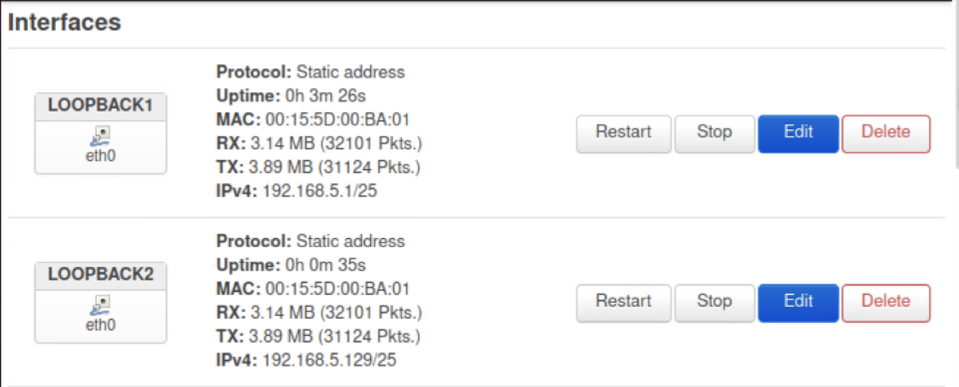
Subnetting and Loopback Interfaces
Objective:
With a class C network and divide its block of IP addresses into smaller blocks (i.e., subnets). Configure two Loopback interfaces on the SOHO Router, by using IP addresses of newly created subnets, to simulate two LAN segments.

Slide 6
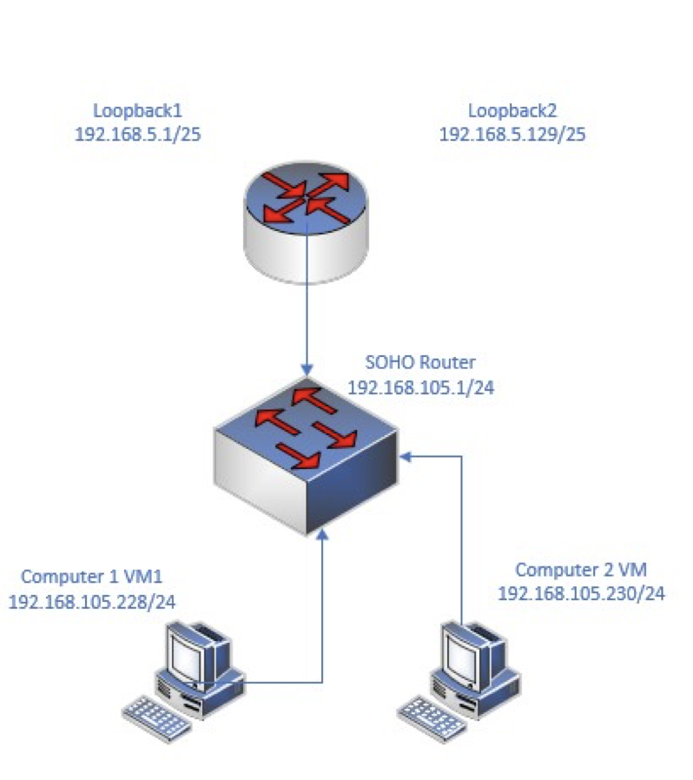
Visio Network
Objective:
Use Microsoft Visio to create a network diagram that depicts the interconnection of the Computer 1 VM, the Computer 2 VM, and the SOHO Router VM.

Slide 7
Challenges
The challenge I faced was understanding the difference between each virtual environment, at first, I thought each one was just a mirror version when it was much deeper than that. Each environment has its own IP Address, making the possibilities endless.

Slide 8
Career Skills
SOHO router configurations
Subnetting
Connectivity testing
Network documentation
SOHO wireless network security
IP Address Configuration

Slide 9
Conclusion
This widens your perspective on the Network, seeing how interconnected multiple IoT devices can be. Everything in the place is essential from addressing the networks to the Wide area network. I can proudly say I have placed a good foundation to prepare for the future IoT.
Arman Pabla

